Slide 1
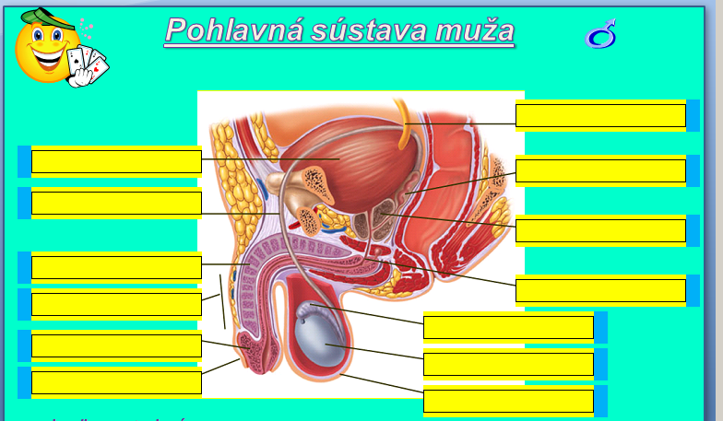
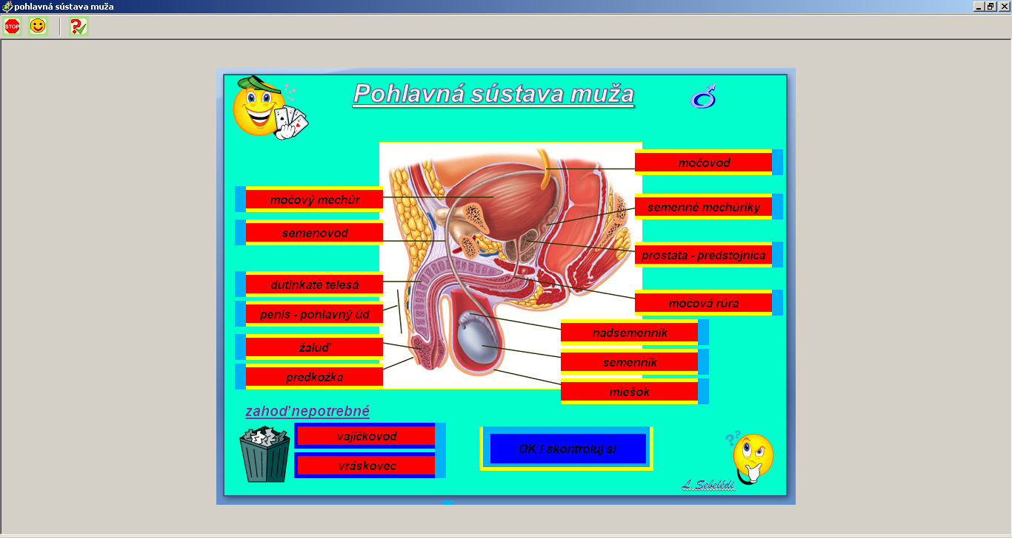

Slide 3
https://www.zborovna.sk/kniznica.php?action=show_version&id=146481

